Slide 1
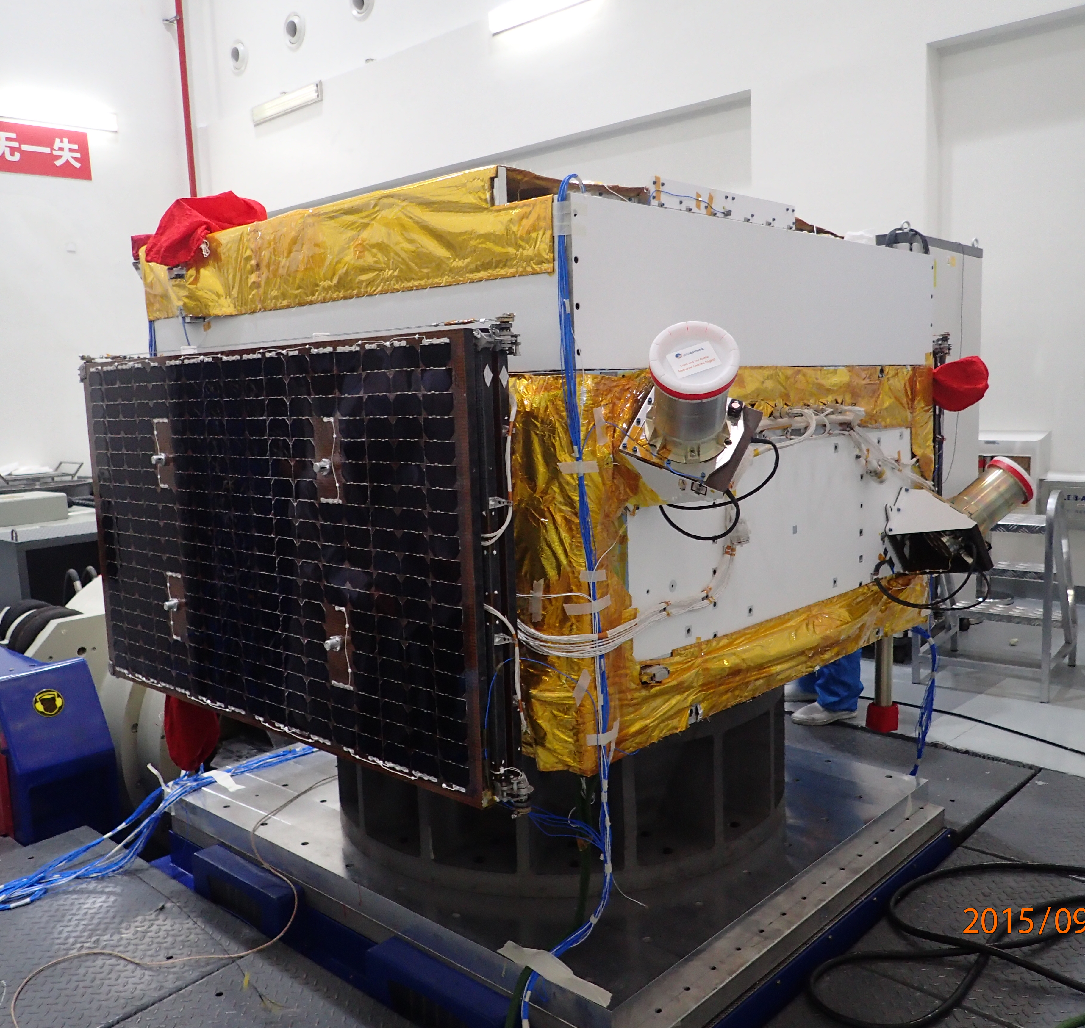

Particle Trajectory reconstruction with deep learning
DAMPE
Kyril Kaufmann
kyril.kaufmann@etu.unige.ch

Slide 2


Dark matter particle Explorer
Bismuth Germanium Oxide (BGO) Calorimeter (14 layers and 22 bars | hodoscope).
Silicon Tungsten tracKer-converter (STK) -> Trajectory reconstruction, absolute charge measurement.
Plastic Scintillator Detector (PSD) -> absolute charge measurement.
NeUtron Detector (NUD)
22 x (2x7)
BGO
STK
PSD
Simulated data. Labbeled and Benchmarked (x,y) BGO entry and exit point.

Slide 3
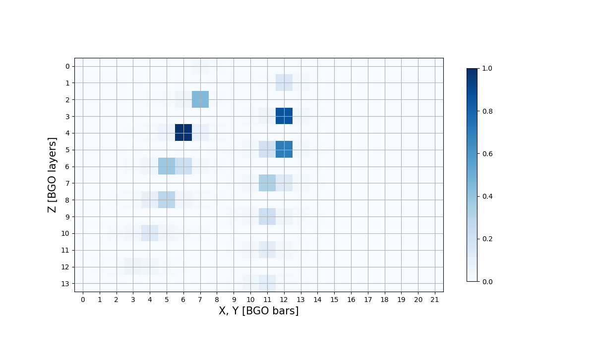
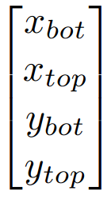
Overview of the task
?
Figure 1 : BGO Calorimeter Shower

Slide 4
Convolutional neural network
22 x 14 x 1 | 8-bits encoded pixels. Relatively big input.
Most of the pixels contain no information
Sharp edge and vicinity effect -> Use of Kernel filter
Figure 2 : BGO Calorimeter Shower

Slide 5
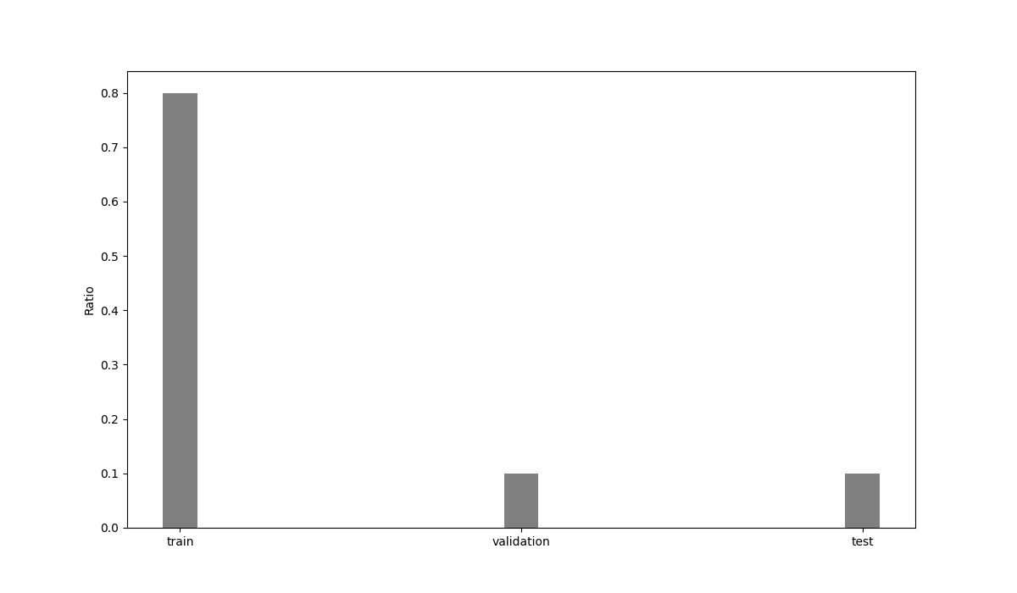
Data preprocessing
Figure 3 : Train, Test, Validation Data Split Proportions

Slide 6
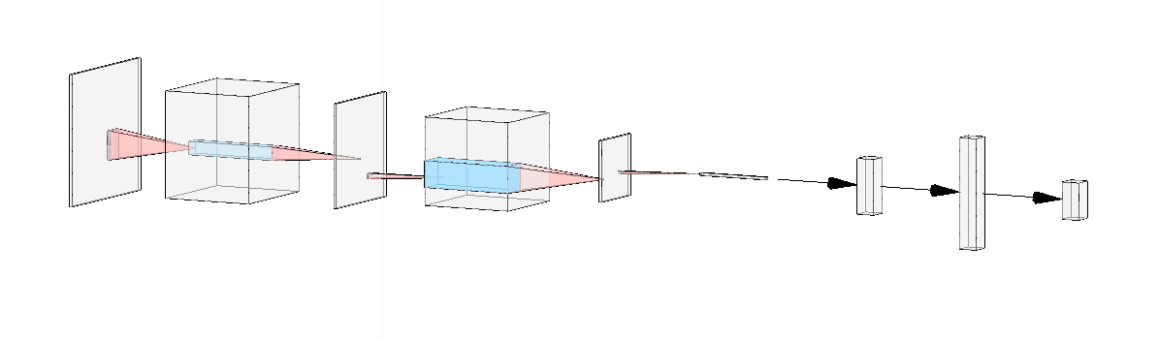
CNN architecture – model 1
Im
Conv
MP
Conv
MP
Hidden
Conv
4x1 output
Layer | Shape | Filter type | Flter (Z x (X / Y) ) | Params
Input | 14 x 22 x 1 | Convolution | 5 x 3 | -
Conv 1 | 10 x 20 x 52 | Max Pooling | 2 x 2 | 832
Max Pooled 1 | 5 x 10 x 42 | Convolution | 5 x 3 | -
Conv 2 | 1 x 8 x 42 | Max Pooling | 1 x 2 | 32802
Max Pooled 2 | 1 x 4 x 32 | Convolution | 1 x 4
Conv 3 | 1 x 1 x 32 | Flatten and Feed-Forward | - | 5408
Dense | 64 | Feed-Forward | - | 2112
Output | 4 | - | - | 260
 |  |  |  | 41'414
Table 1 : Model 1 details

Slide 7
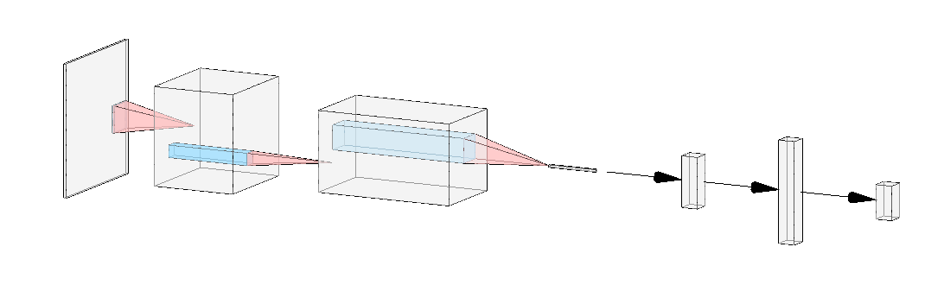
CNN architecture – model 2
Layer | Shape | Filter type | Flter (Z x (X / Y) ) | Params
Input | 14 x 22 x 1 | Convolution | 5 x 4 | -
Conv 1 | 10 x 19 x 32 | Convolution | 5 x 4 | 672
Conv 2 | 6 x 16 x 32 | Convolution | 6 x 16 | 20512
Conv 3 | 1 x 1 x 8 | Flatten and Feed-Forward | - | 24584
Dense | 64 | Feed-Forward | - | 576
Output | 4 | - | - | 260
 |  |  |  | 46'604
Table 2 : Model 2 details
Im
Conv
Conv
Hidden
Conv
4x1 output

Slide 8
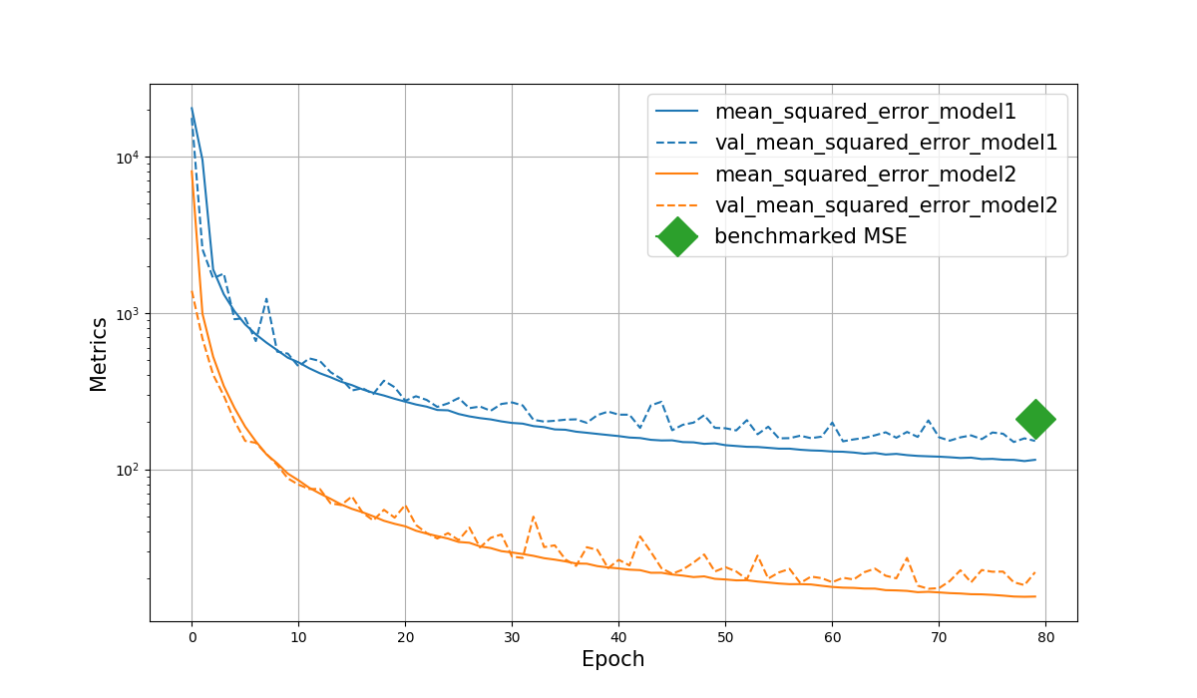
CNN model comparison
Figure 4 : Model 1 and 2 History compared to benchmarked data

Slide 9
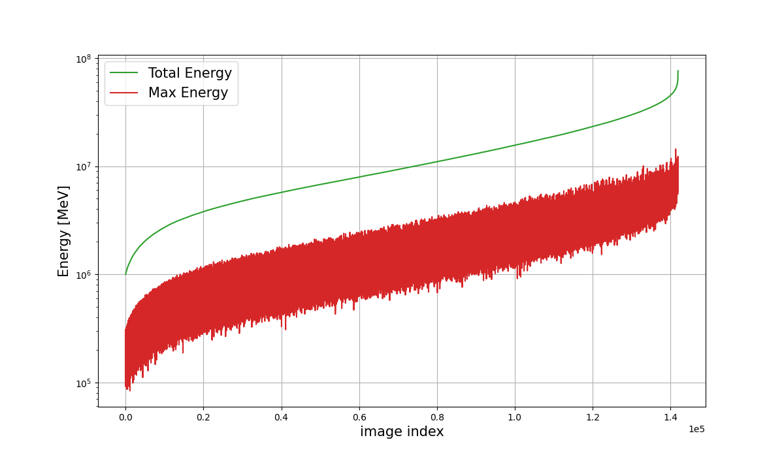
Using particle energy
Figure 5 : Shower total energy and pixel maximum energy

Slide 10
Energy split model
One model with different training set (split on low and high energy)
Layer | Shape | Filter type | Flter (Z x (X / Y) ) | Params
Input | 14 x 22 x 1 | Convolution | 5 x 4 | -
Conv 1 | 10 x 19 x 8 | Convolution | 5 x 4 | 168
Conv 2 | 6 x 16 x 16 | Convolution | 6 x 16 | 2576
Conv 3 | 1 x 1 x 16 | Flatten and Feed-Forward | - | 24592
Dense | 64 | Feed-Forward | - | 1088
Output | 4 | - | - | 260
 |  |  |  | 28'684
Im
Conv
Table 3 : Model Split details
Conv
Hidden
Conv
4x1 output

Slide 11
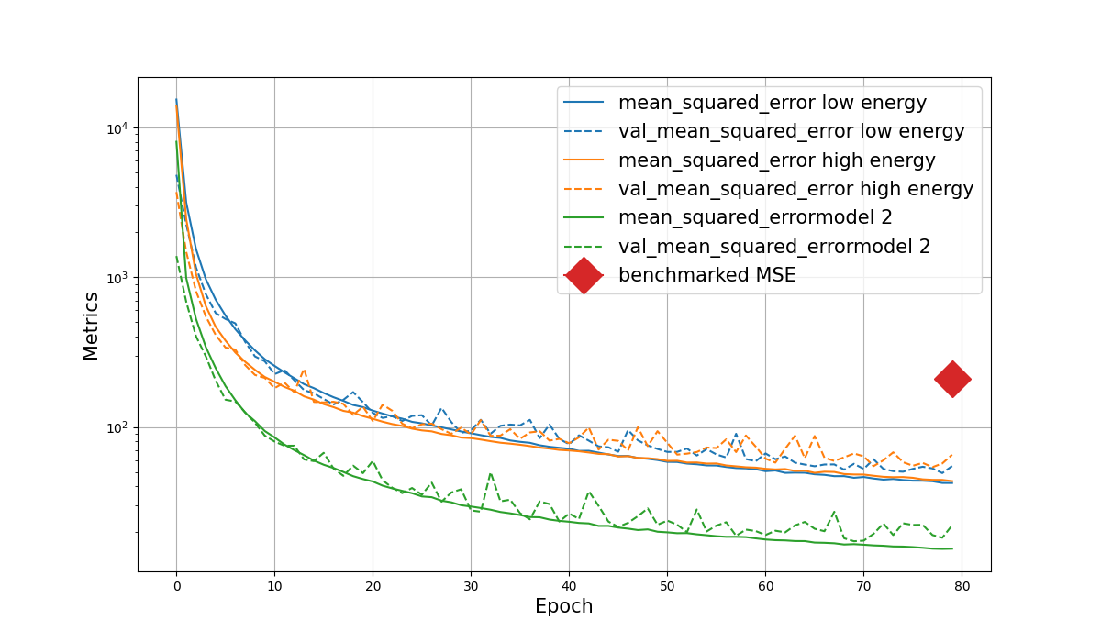
Energy split cnn model result
Figure 6 : Split models and Model 2 History compared to benchmarked data

Slide 12
Conclusion
Adding more layers in the feed-forward deteriorates the results.
Increasing the filter size at each convolution yields poorer result.
Image of size 14 x 22 -> Input of size 36 * 1e6 : Try a model with more parameters.
Split on the maximum pixel energy instead of total energy.
Do not fully flatten the image in the convolutional network.
Use transformers to include attention between X and Y.

